Slide 1
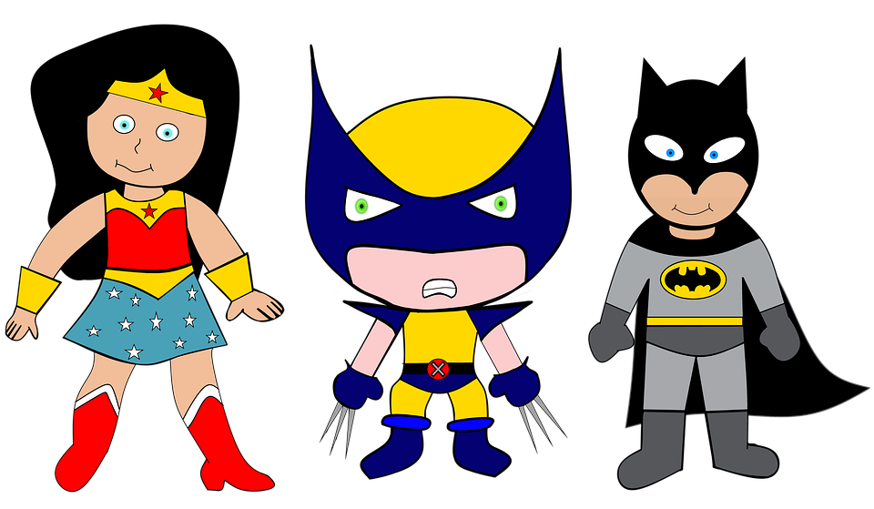
We are SUPERheroes! Students Using their Powers to Engage in Reading!
Kindergarten Newsletter – February 28 – March 4, 2022
IMPORTANT EVENTS
Breakfast ends at 7:25!
 | Dr. Seuss Week
The EXPERT in anything was once a BEGINNER!
HOMEWORK
Mon. – Thurs. | Weekly ELA Sheet Math HW Pages Practice Sight Words List Read 10 minutes per night
WEEKLY ASSESSMENTS
ELA | Module 6.4 Listening test Oral Reading Fluency test Medial Vowel test Spelling Test ( van,zip,zap, sap, lap, can , yam)
Math | Lesson 21 and 22 test
SCHOOL NEWS
Don’t forget you can order yearbooks online. Our new Phonics program starts promptly at 7:45 a.m. everyday, so be sure your child is here before 7:30 a.m. We don’t want them to miss a minute of learning!
WEEKLY MATH SKILLS
Unknown number Writing 1,2,3,4,5,6,7,8,9,10 Teen numbers Decompose numbers 3-10 Adding/subtracting to 10
REMINDERS
Please make sure all money is sent in your child’s blue folder labeled and sealed. If your child is absent, please send an excuse labeled with the following information: Child’s name, date of absence, teacher’s name, and reason for absence.
SCHOOL SAFETY
Be sure your child wears a mask to school DAILY!

Slide 2
Module 6 Week 4: Home of the Free and the Brave
LEARNING MINDSET: Asking for Help
ESSENTIAL QUESTION
What makes the USA special?
PHONICS
Introduce : S blends & L blends - eep word family
READING
Genre: Fiction Story Elements: Characters, Settings, Events Informational Texts | Listening Comprehension Parts of a Book Collaborative discussions
WORDS TO KNOW
Cut Must Said when
VOCABULARY
BIG IDEA WORDS: Belong, Country, Right POWER WORDS: American, crowd, customer Books: Apple Pie 4th of July and Happy Birthday to the U.S.!
REVIEW
Letters and sounds Aa-Ff Gg-Pp Qq-Zz
WRITING
Nouns and Verbs Characters/Setting Narratives
SPELLING WORDS
van zip zap sap lap can yam
PHONEMIC AWARENESS
Identify Rhymes Identify Syllables Beg., Medial, Final Sounds

